Slide 1

Cloud-Based Data Visualization and Forecasting System for S&P 500 Trends with Sentiment Integration
Presented By
Name : Satwika Rani Bedapudi
Student Number: 3164483
Under the supervision of
Katerina Kanta
Submitted in partial fulfillment of the requirements for the degree of
Master of Science in Computing Science
Griffith College, September 2025

Slide 2
OUTLINE
Abstract
Introduction
Problem Definition
Objectives
Methodology
Proposed System
Sequence Diagram
Analysis
Outputs
conclusion

Slide 3
ABSTRACT
This project presents a hybrid forecasting framework that integrates traditional time-series forecasting models with sentiment analysis and cloud-based visualization. The S&P 500 stock data was dynamically collected using multiple fallback mechanisms, cleaned, and processed for forecasting. Prophet and XGBoost algorithms were employed, and results showed that XGBoost provided superior accuracy. Sentiment data from Yahoo Finance, Google News, Reddit, and NewsAPI was incorporated to enhance predictions. Finally, the pipeline was deployed to AWS, with data stored in S3, visualized in QuickSight, and enhanced with LLM-based insights using AWS Q.

Slide 4
INTRODUCTION
Forecasting stock market trends is challenging due to volatility, nonlinear patterns, and sudden fluctuations.
Traditional models like Prophet rely mainly on historical data, limiting accuracy in dynamic markets.
Market sentiment, influenced by news and social media, significantly affects stock price movements.
This project introduces a hybrid model combining XGBoost and Prophet to leverage both predictive power and interpretability.
Real-time sentiment integration improves forecasting accuracy, especially for perception-sensitive stocks.
Deployment on AWS (S3, QuickSight, AWS Q) ensures scalability, dynamic visualization, and interactive insights.

Slide 5
PROBLEM DEFINITION
Existing stock forecasting methods primarily rely on historical data and often overlook qualitative factors such as news, social media trends, and investor sentiment. This limitation reduces their ability to capture sudden market shifts caused by perception-driven events, resulting in less accurate predictions. Additionally, traditional models frequently lack scalability and seamless integration with cloud-based visualization tools, restricting their usefulness for real-time decision-making. This project addresses these issues by combining XGBoost and Prophet with sentiment analysis, while deploying the system on AWS for scalable storage, interactive visualizations, and actionable insights, enabling more accurate and adaptive stock market forecasting.

Slide 6
OBJECTIVES
Develop a hybrid stock forecasting system using Prophet and XGBoost.
Evaluate and compare model performance using metrics such as MAE and RMSE.
Incorporate market sentiment data to improve prediction accuracy and capture perception-driven trends.
Implement cloud-based storage and processing on AWS for scalability and efficient data management.
Create interactive visualizations using AWS QuickSight for intuitive insights.
Leverage AWS Q to provide enhanced, AI-driven analytical insights for decision-makers.

Slide 7
METHODOLOGY
The methodology followed includes:
Data Collection: Dynamically fetching S&P 500 stock data with Wikipedia and EODHD API as a fallback.
Data Preprocessing: Cleaning and preparing historical data for analysis.
Forecasting: Applying Prophet and XGBoost for future trend predictions.
Sentiment Analysis: Collecting sentiment scores from Yahoo Finance, Google News, Reddit, and NewsAPI.
Model Integration: Incorporating sentiment into XGBoost for enhanced forecasting.
Cloud Deployment: Storing data in AWS S3, visualizing in QuickSight, and enabling insights via AWS Q.

Slide 8
XGBoost vs Prophet – Model Comparison
XGBoost consistently outperforms Prophet across most S&P 500 stocks.
Positive improvement % → XGBoost better
Negative % → Prophet better.
The histogram shows the majority of stocks on the positive side, meaning XGBoost reduces forecasting error for most cases.
MAE is chosen for visualization as it gives a clear, interpretable measure of average error.
Both MAE and RMSE statistical tests confirm XGBoost’s superiority (p-values < 1e-58).
Conclusion: XGBoost is the best model for accurate, production-grade stock forecasting.

Slide 9
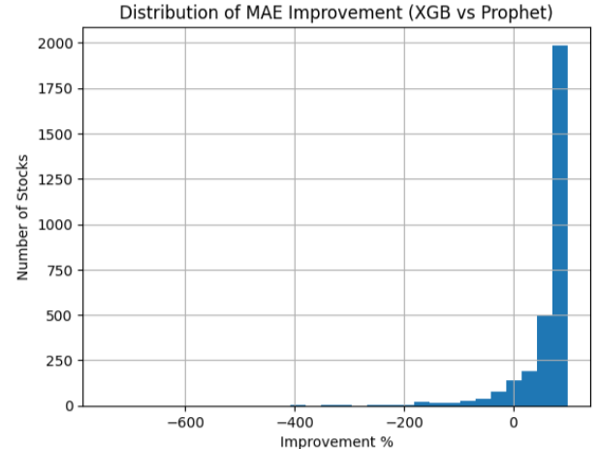
XGBoost vs Prophet – Model Comparison

Slide 10
SENTIMENT INTEGRATION IN FORECASTING
Title: Why Add Sentiment to XGBoost Models?
Captures market psychology beyond price & volume
Sentiment directly reflects market psychology, which influences short-term price moves. It complements technical indicators.
Helps explain short-term price reactions to news
Valuable for consumer-driven & tech sectors
Complements technical indicators with non-linear interactions

Slide 11
PERFORMANCE RESULTS
Impact of Sentiment on Forecast Accuracy:
Models compared:
Baseline (No Sentiment)
Sentiment-Enhanced
Ticker breakdown:
216 tickers (42.9%) improved with sentiment
287 tickers (57.1%) worsened with sentiment
Sectors like tech, consumer discretionary, and retail are more sentiment-driven.
Others like utilities, industrials, or stable healthcare depend more on fundamentals and less on news.
Adding sentiment to low-sensitivity sectors can dilute predictive accuracy.

Slide 12
Sentiment is not universally useful → apply selectively
Build ticker-specific models:
Use the sentiment model if RMSE improves
Otherwise, stick to the baseline model
43% of S&P 500 tickers benefit from sentiment → especially in high-news, high-volatility stocks.
Many studies assume sentiment always improves accuracy. I show it’s ticker-dependent, with ~43% benefiting and ~57% harmed.
Future scope:
Improve news quality filtering
Sector-level sentiment weighting
Dynamic model switching
SENTIMENT ANALYSIS CONCLUSION

Slide 13
AWS INTEGRATION
All data and forecasting results were pushed to AWS S3, ensuring reliable cloud storage. Using AWS QuickSight, preprocessing and visualization of forecasting trends were performed. Furthermore, AWS Q was integrated to provide natural language insights, allowing stakeholders to query stock performance interactively and gain deeper understanding from the models.

Slide 14
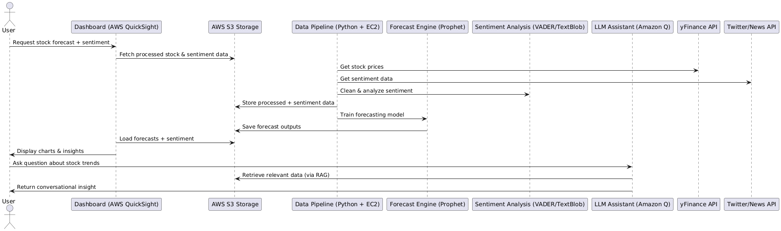
SEQUENCE DIAGRAM

Slide 15
CONCLUSION
This project demonstrated that XGBoost provides better forecasting accuracy than Prophet for S&P 500 stocks. While sentiment integration did not universally improve performance, it significantly benefited specific stocks that are heavily influenced by public perception. Deploying the pipeline on AWS ensured scalability, interactive visualization, and cloud-native insights.

Slide 16
FUTURE WORK
Future enhancements could include fine-tuning the weighting of sentiment features, integrating global indices for broader applicability, and incorporating deep learning methods such as LSTM or Transformer-based models to capture long-term dependencies and market dynamics.

Slide 17
DATASET LINK
https://en.wikipedia.org/wiki/List_of_S%26P_500_companies#S&P_500_component_stocks

Slide 18
T
H
A
N
K
Y
O
U

